Slide 1

CHAPTER 3
THE LOGIC OF
QUANTIFIED
STATEMENTS
Copyright © Cengage Learning. All rights reserved.

Slide 2
SECTION 3.1
Predicates and Quantified Statements I
Copyright © Cengage Learning. All rights reserved.

Slide 3
Predicates and Quantified Statements I
In logic, predicates can be obtained by removing some or all of the nouns from a statement. For instance, let P stand for “is a student at Bedford College” and let Q stand for “is a student at.” Then both P and Q are predicate symbols.
The sentences “x is a student at Bedford College” and “x is a student at y” are symbolized as P(x) and as Q(x, y) respectively, where x and y are predicate variables that take values in appropriate sets.
When concrete values are substituted in place of predicate variables, a statement results.

Slide 4
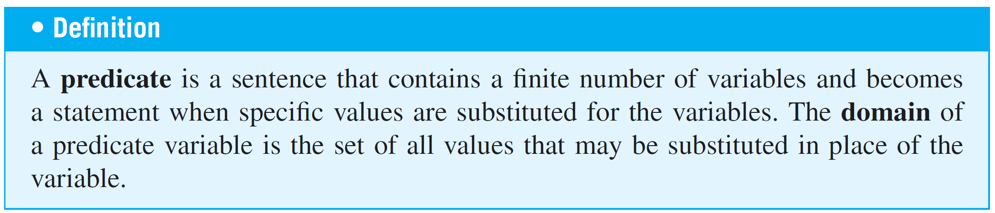
Predicates and Quantified Statements I
For simplicity, we define a predicate to be a predicate symbol together with suitable predicate variables. In some other treatments of logic, such objects are referred to as propositional functions or open sentences.

Slide 5
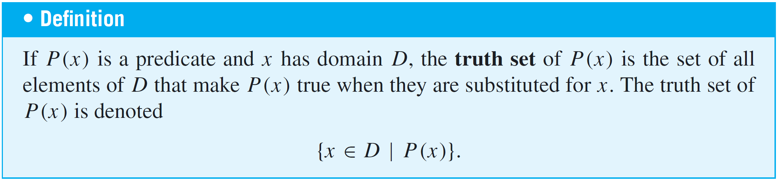
Predicates and Quantified Statements I
When an element in the domain of the variable of a
one-variable predicate is substituted for the variable, the resulting statement is either true or false. The set of all such elements that make the predicate true is called the truth set of the predicate.

Slide 6
Example 2 – Finding the Truth Set of a Predicate
Let Q(n) be the predicate “n is a factor of 8.” Find the truth set of Q(n) if
a. the domain of n is the set Z⁺ of all positive integers
b. the domain of n is the set Z of all integers.
Solution:
a. The truth set is {1, 2, 4, 8} because these are exactly the positive integers that divide 8 evenly.
b. The truth set is {1, 2, 4, 8,−1,−2,−4,−8} because the negative integers −1,−2,−4, and −8 also divide into 8 without leaving a remainder.

Slide 7
The Universal Quantifier: ∀

Slide 8
The Universal Quantifier: ∀
One sure way to change predicates into statements is to assign specific values to all their variables.
For example, if x represents the number 35, the sentence “x is (evenly) divisible by 5” is a true statement since 35 = 5  7. Another way to obtain statements from predicates is to add quantifiers.
Quantifiers are words that refer to quantities such as “some” or “all” and tell for how many elements a given predicate is true.

Slide 9
The Universal Quantifier: ∀
The symbol ∀ denotes “for all” and is called the universal quantifier.
The domain of the predicate variable is generally indicated between the ∀ symbol and the variable name or immediately following the variable name. Some other expressions that can be used instead of for all are for every, for arbitrary, for any, for each, and given any.

Slide 10
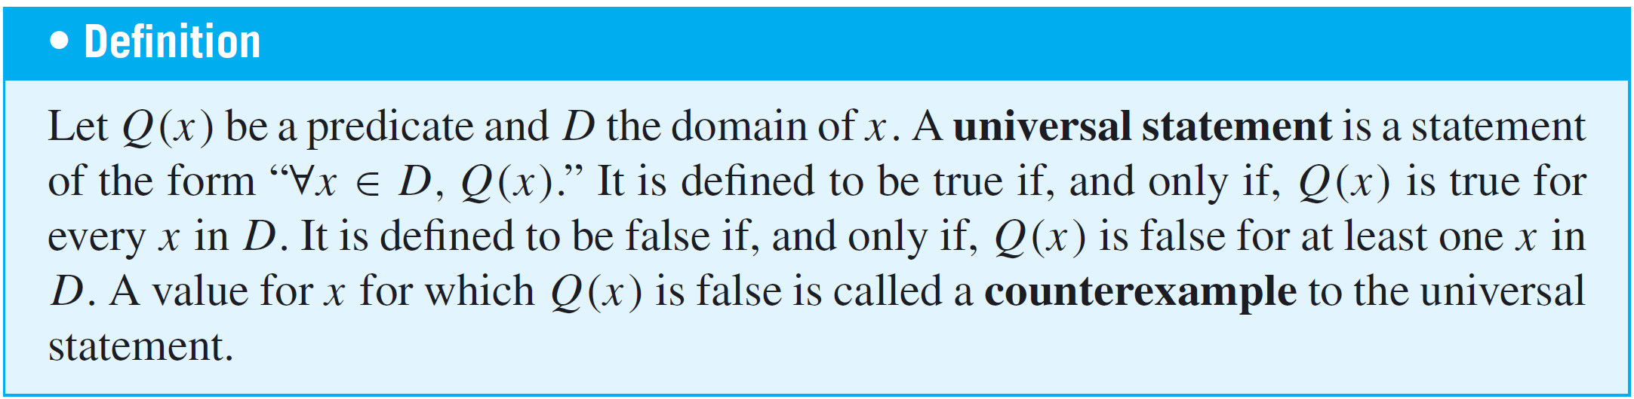
The Universal Quantifier: ∀
Sentences that are quantified universally are defined as statements by giving them the truth values specified in the following definition:

Slide 11


Example 3 – Truth and Falsity of Universal Statements
a. Let D = {1, 2, 3, 4, 5}, and consider the statement
Show that this statement is true.
b. Consider the statement
Find a counterexample to show that this statement is
false.

Slide 12

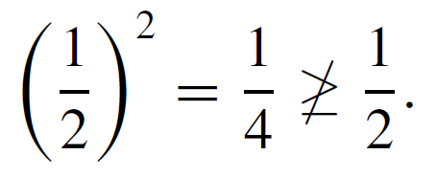
Example 3 – Solution
a. Check that “x² ≥ x” is true for each individual x in D.
Hence “∀x ∈ D, x² ≥ x” is true.
b. Counterexample: Take x = . Then x is in R (since is a real number) and
Hence “∀x ∈ R, x² ≥ x” is false.

Slide 13
The Universal Quantifier: ∀
The technique used to show the truth of the universal statement in Example 3(a) is called the method of exhaustion.
It consists of showing the truth of the predicate separately for each individual element of the domain.
This method can, in theory, be used whenever the domain of the predicate variable is finite.

Slide 14
The Existential Quantifier: ∃

Slide 15
The Existential Quantifier: ∃
The symbol ∃ denotes “there exists” and is called the existential quantifier. For example, the sentence “There is a student in Math 140” can be written as
∃ a person p such that p is a student in Math 140,
or, more formally,
∃p ∈ P such that p is a student in Math 140,
where P is the set of all people. The domain of the predicate variable is generally indicated either between the ∃ symbol and the variable name or immediately following the variable name.

Slide 16
The Existential Quantifier: ∃
The words such that are inserted just before the predicate. Some other expressions that can be used in place of there exists are there is a, we can find a, there is at least one, for some, and for at least one.
In a sentence such as “∃ integers m and n such that m + n = m  n,” the ∃ symbol is understood to refer to both m and n.

Slide 17
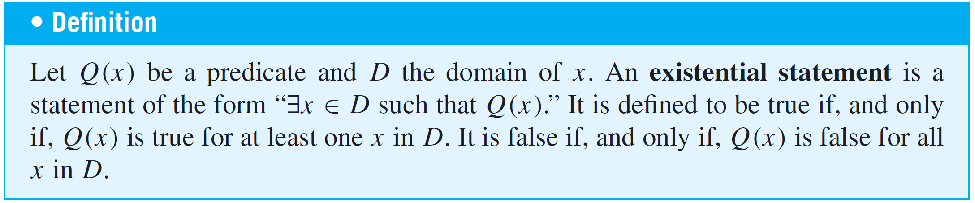
The Existential Quantifier: ∃
Sentences that are quantified existentially are defined as statements by giving them the truth values specified in the following definition.

Slide 18
Example 4 – Truth and Falsity of Existential Statements
a. Consider the statement
∃m ∈ Z⁺ such that m² = m.
Show that this statement is true.
b. Let E = {5, 6, 7, 8} and consider the statement
∃m ∈ E such that m² = m.
Show that this statement is false.

Slide 19
Example 4 – Solution
a. Observe that 1² = 1. Thus “m² = m” is true for at least
one integer m. Hence “∃m ∈ Z such that m² = m” is true.
b. Note that m² = m is not true for any integers m from 5 through 8:
Thus “∃m ∈ E such that m² = m” is false.

Slide 20
Formal Versus Informal Language

Slide 21
Formal Versus Informal Language
It is important to be able to translate from formal to informal language when trying to make sense of mathematical concepts that are new to you.
It is equally important to be able to translate from informal to formal language when thinking out a complicated problem.

Slide 22



Example 5 – Translating from Formal to Informal Language
Rewrite the following formal statements in a variety of equivalent but more informal ways. Do not use the symbol ∀ or ∃.
a.
b.
c.

Slide 23
Example 5 – Solution
a. All real numbers have nonnegative squares.
Or: Every real number has a nonnegative square.
Or: Any real number has a nonnegative square.
Or: The square of each real number is nonnegative.
b. All real numbers have squares that are not equal to −1.
Or: No real numbers have squares equal to −1.
(The words none are or no . . . are are equivalent to the words all are not.)

Slide 24
Example 5 – Solution
cont’d
c. There is a positive integer whose square is equal to itself.
Or: We can find at least one positive integer equal to its own square.
Or: Some positive integer equals its own square.
Or: Some positive integers equal their own squares.

Slide 25
Universal Conditional Statements

Slide 26
Universal Conditional Statements
A reasonable argument can be made that the most important form of statement in mathematics is the universal conditional statement:
∀x, if P(x) then Q(x).
Familiarity with statements of this form is essential if you are to learn to speak mathematics.

Slide 27
Example 8 – Writing Universal Conditional Statements Informally
Rewrite the following statement informally, without quantifiers or variables.
∀x ∈ R, if x > 2 then x² > 4.
Solution:
If a real number is greater than 2 then its square is greater than 4.
Or: Whenever a real number is greater than 2, its square is
greater than 4.

Slide 28
Example 8 – Solution
cont’d
Or: The square of any real number greater than 2 is greater
than 4.
Or: The squares of all real numbers greater than 2 are
greater than 4.

Slide 29
Equivalent Forms of Universal
and Existential Statements

Slide 30
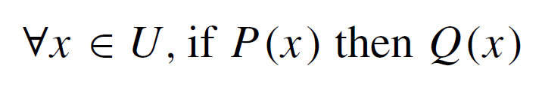
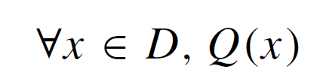
Equivalent Forms of Universal and Existential Statements
Observe that the two statements “∀ real numbers x, if x is an integer then x is rational” and “∀ integers x, x is rational” mean the same thing.
Both have informal translations “All integers are rational.” In fact, a statement of the form
can always be rewritten in the form
by narrowing U to be the domain D consisting of all values of the variable x that make P(x) true.

Slide 31
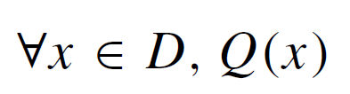
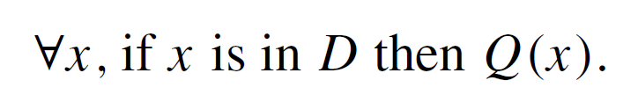
Equivalent Forms of Universal and Existential Statements
Conversely, a statement of the form
can be rewritten as

Slide 32
Example 10 – Equivalent Forms for Universal Statements
Rewrite the following statement in the two forms “∀x, if ______ then ______” and “∀ ______x, _______”: All squares are rectangles.
Solution:
∀x, if x is a square then x is a rectangle.
∀ squares x, x is a rectangle.

Slide 33
Equivalent Forms of Universal and Existential Statements
Similarly, a statement of the form
“∃x such that p(x) and Q(x)”
can be rewritten as
“∃x εD such that Q(x),”
where D is the set of all x for which P(x) is true.

Slide 34
Example 11 – Equivalent Forms for Existential Statements
A prime number is an integer greater than 1 whose only positive integer factors are itself and 1. Consider the statement “There is an integer that is both prime and even.”
Let Prime(n) be “n is prime” and Even(n) be “n is even.” Use the notation Prime(n) and Even(n) to rewrite this statement in the following two forms:
a. ∃n such that ______ ∧ ______ .
b. ∃ ______ n such that ______.

Slide 35
Example 11 – Solution
a. ∃n such that Prime(n) ∧ Even(n).
b. Two answers: ∃ a prime number n such that Even(n).
∃ an even number n such that Prime(n).

Slide 36
Implicit Quantification

Slide 37
Implicit Quantification
Mathematical writing contains many examples of implicitly quantified statements. Some occur, through the presence of the word a or an. Others occur in cases where the general context of a sentence supplies part of its meaning.
For example, in an algebra course in which the letter x is always used to indicate a real number, the predicate
If x > 2 then x² > 4
is interpreted to mean the same as the statement
∀ real numbers x, if x > 2 then x² > 4.

Slide 38
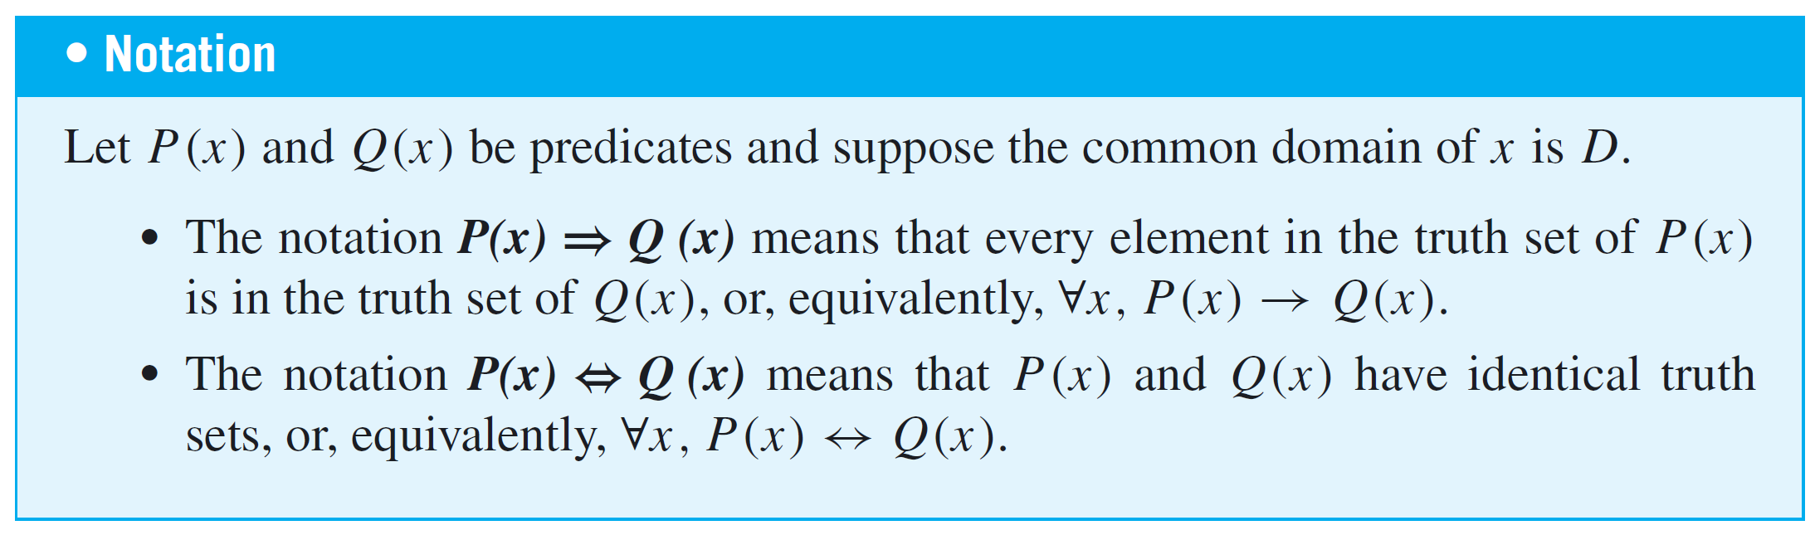
Implicit Quantification
Mathematicians often use a double arrow to indicate implicit quantification symbolically.
For instance, they might express the above statement as
x > 2 ⇒ x² > 4.

Slide 39
Example 12 – Using ⇒ and ⇔
Let
Q(n) be “n is a factor of 8,”
R(n) be “n is a factor of 4,”
S(n) be “n < 5 and n ≠ 3,”
and suppose the domain of n is Z⁺, the set of positive integers. Use the ⇒ and ⇔ symbols to indicate true relationships among Q(n), R(n), and S(n).

Slide 40
Example 12 – Solution
1. As noted in Example 2, the truth set of Q(n) is {1, 2, 4, 8}
when the domain of n is Z⁺. By similar reasoning the
truth set of R(n) is {1, 2, 4}.
Thus it is true that every element in the truth set of R(n)
is in the truth set of Q(n), or, equivalently,
∀n in Z⁺, R(n) → Q(n).
So R(n) ⇒ Q(n), or, equivalently
n is a factor of 4 ⇒ n is a factor of 8.

Slide 41
Example 12 – Solution
cont’d
2. The truth set of S(n) is {1, 2, 4}, which is identical to the
truth set of R(n), or, equivalently,
∀n in Z⁺, R(n) ↔ S(n).
So R(n) ⇔ S(n), or, equivalently,
n is a factor of 4 ⇔ n < 5 and n ≠ 3.
Moreover, since every element in the truth set of S(n) is
in the truth set of Q(n), or, equivalently,
∀n in Z⁺, S(n) → Q(n), then S(n) ⇒ Q(n), or, equivalently,
n < 5 and n ≠ 3 ⇒ n is a factor of 8.

Slide 42
Tarski’s World

Slide 43
Tarski’s World
Tarski’s World is a computer program developed by information scientists Jon Barwise and John Etchemendy to help teach the principles of logic.
It is described in their book The Language of First-Order Logic, which is accompanied by a CD-Rom containing the program Tarski’s World, named after the great logician Alfred Tarski.

Slide 44
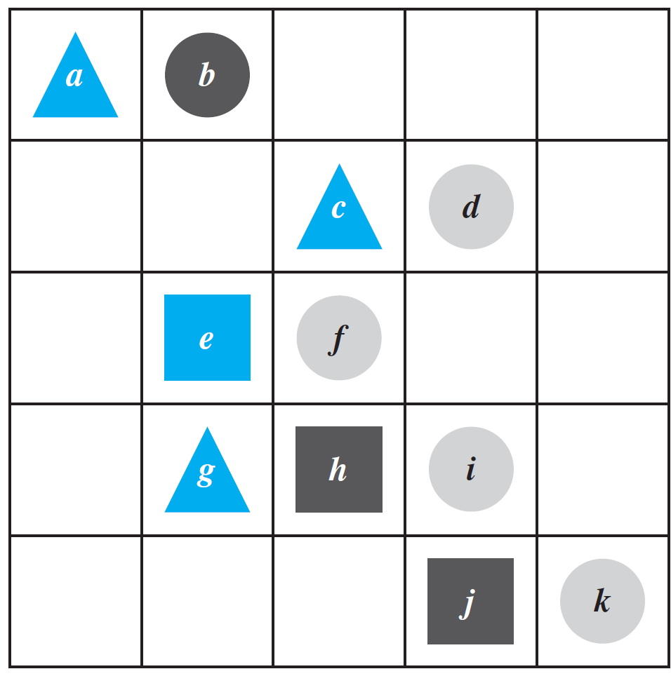
Example 13 – Investigating Tarski’s World
The program for Tarski’s World provides pictures of blocks of various sizes, shapes, and colors, which are located on a grid. Shown in Figure 3.1.1 is a picture of an arrangement of objects in a two-dimensional Tarski world.
Figure 3.1.1

Slide 45
Example 13 – Investigating Tarski’s World
cont’d
The configuration can be described using logical operators and—for the two-dimensional version—notation such as Triangle(x), meaning “x is a triangle,” Blue(y), meaning “y is blue,” and RightOf(x, y), meaning “x is to the right of y (but possibly in a different row).” Individual objects can be given names such as a, b, or c.

Slide 46
Example 13 – Investigating Tarski’s World
cont’d
Determine the truth or falsity of each of the following statements. The domain for all variables is the set of objects in the Tarski world shown above.
a. ∀t, Triangle(t) → Blue(t).
b. ∀x, Blue(x) → Triangle(x).
c. ∃y such that Square(y) ∧ RightOf(d, y).
d. ∃z such that Square(z) ∧ Gray(z).

Slide 47
Example 13 – Solution
a. This statement is true: All the triangles are blue.
b. This statement is false. As a counterexample, note that e is blue and it is not a triangle.
c. This statement is true because e and h are both square and d is to their right.
d. This statement is false: All the squares are either blue or black.

